Slide 1
Coding Challenge
Timed
Interview

Slide 2
Contents
This is a coding interview with five questions and a total duration of approximately 1 hour. We are looking for code that is clean, readable, performant, and maintainable.
There are five rounds - four questions to be completed individually and the last question is to be completed in a team. You have 10 minutes to complete each individual question and 15 minutes to complete the team question. There will be a reminder when a minute is left for each round. Each question is in the form of a google form where your code has to be submitted. You will get 30 seconds to submit your answer for each question. Please make sure to submit your code into the long-answer text.
The languages you are being tested on are as follows :
JavaScript
C++
Python
Solidity
Web Design

Slide 3
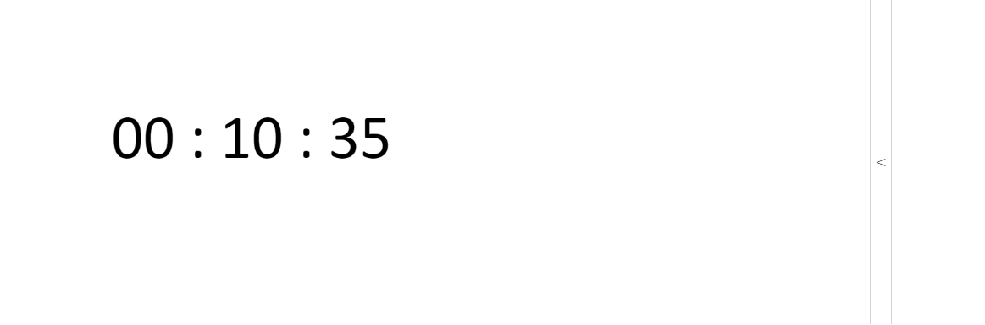
JavaScript
1. Write a JavaScript function that does the following :
Console logs the number from 1 to n, where n is the integer, the function takes as its parameter
Logs “triz” instead of the number for multiples of 3
Logs “penta” instead of the number for multiples of 5
Logs “tripenta” for numbers that are multiples of both 3 and 5

Slide 4
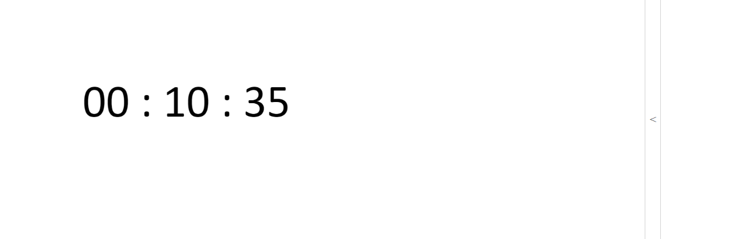
C++
2. Write a simple code snippet that has a function to control movement of an object using the arrow keys.

Slide 5
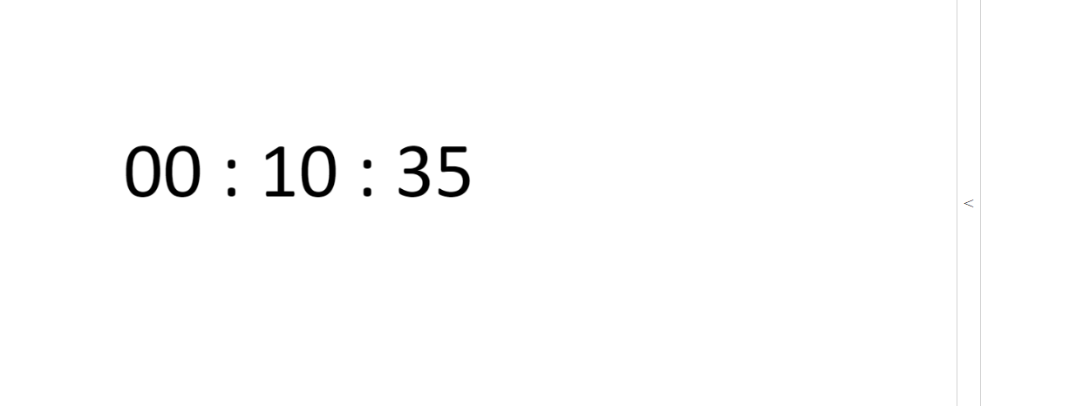
Python
3. Write a program that accepts a comma separated sequence of words as input and prints the words in a comma-separated sequence after sorting them alphabetically.
For example -
If input is - “bag, hello, apple, world, war
Then output should be - “apple, bag, hello, war, world”

Slide 6
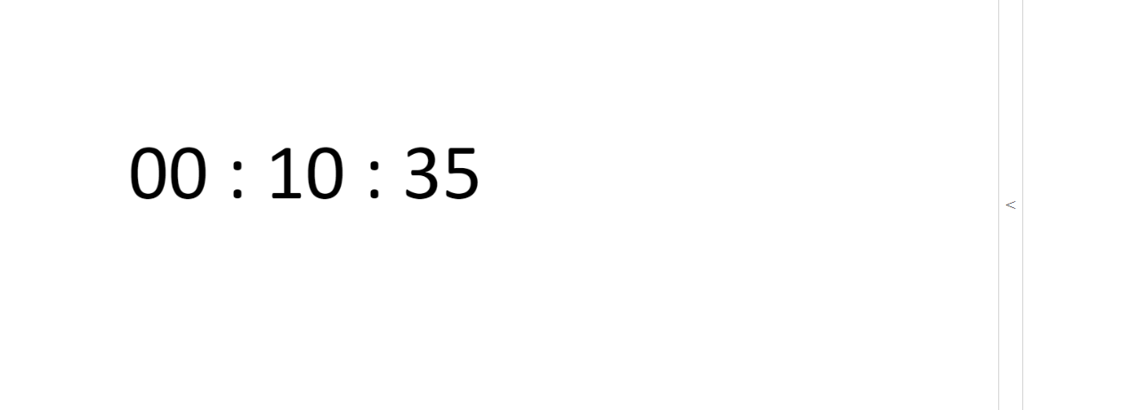
Solidity
4. Write a simple smart contract in solidity, that will allow us to store an unsigned integer and retrieve it. You can use Remix IDE to deploy your contract on any of the test networks like Ropsten/Rinkeby.

Slide 7
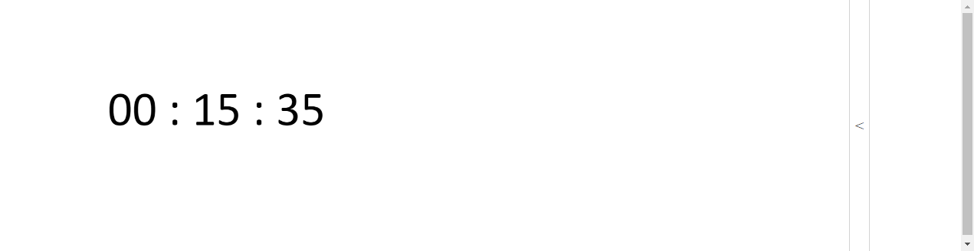
Web Design (Team Work)
5. In 15 minutes, come up with a simple yet creative design with a web page for an educational platform. You can use whatever tools you wish to use, and whatever design you see fit. Here are a few things to keep in mind :
The webpage should be consistent and convery a good brand guideline
There should be a proper format (header, body, footer)
There is no need for too much information given the time limit. Cover the information you believe is important to be on the web page with minimal info.

Slide 8

Thank You
Have A Good Day!

